Slide 1
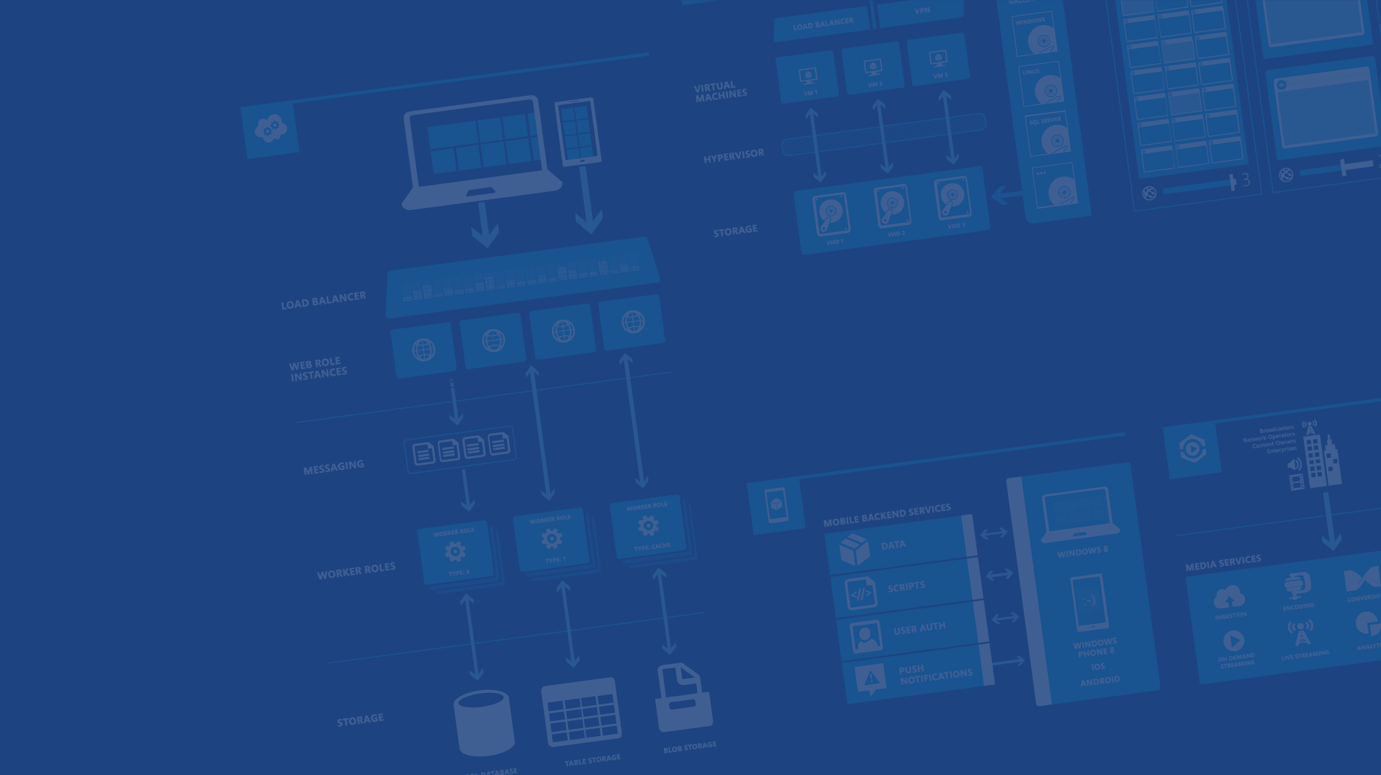
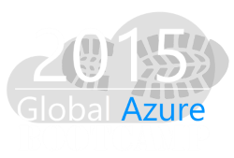

Automating Azure VMs with PowerShell
Feschenko Alexander
Senior Software Engineer @ EPAM Systems
Blog: feschenkoalex.blogspot.com
Email: feschenko.alex@gmail.com
Microsoft Azure
Notes:
Presentation Objectives:
This presentation provides a high-level overview of Azure IaaS. It covers essential concepts and tools for people who are new to Azure to get started. It covers both Virtual Machines and Virtual Networks.
Speaker Notes:
It’s important for the speaker to reiterate the first segment, which should have been covered by the “Design Cloud Solutions” session earlier.
Given there are lots of contents to be covered, the speaker should focus on only high-level concepts instead of drilling too much into details.

Slide 2
Agenda
Intro to Windows Azure PowerShell
Automating Azure virtual machines. Base cmdlets description
Demo Session. Create and configure virtual machine. Provision and configure frontend and backend parts
Migrating applications to the Cloud with Azure IaaS
Notes:
Slide Objectives:
Explain the agenda of the session.
Speaker Notes:
Explain this presentation is a high-level overview, so not everything is covered in-depth.

Slide 3
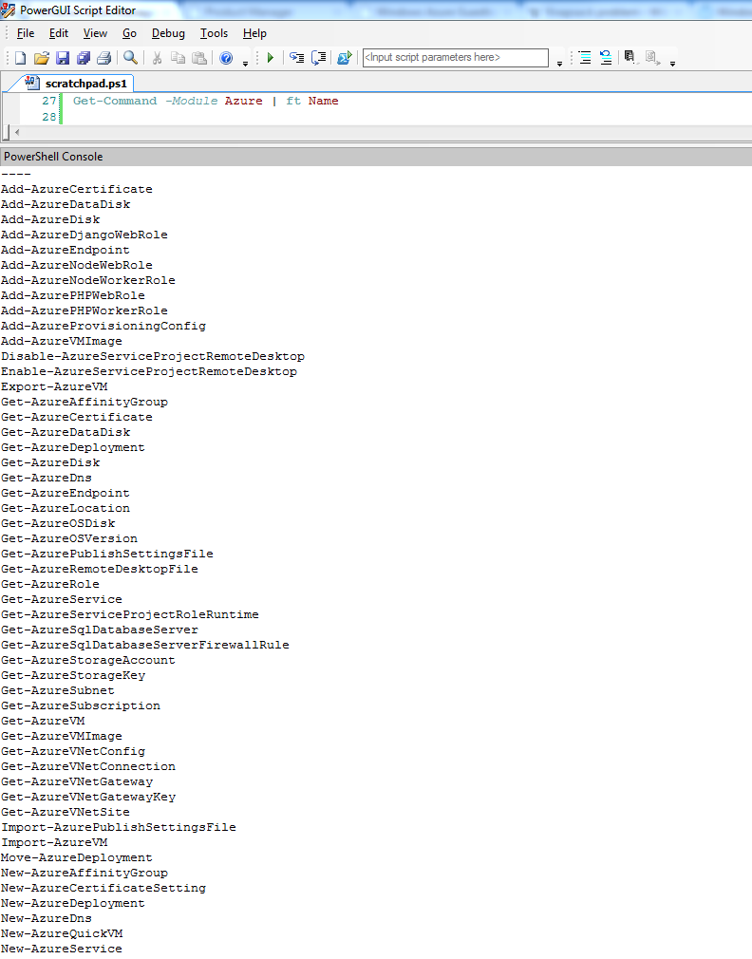
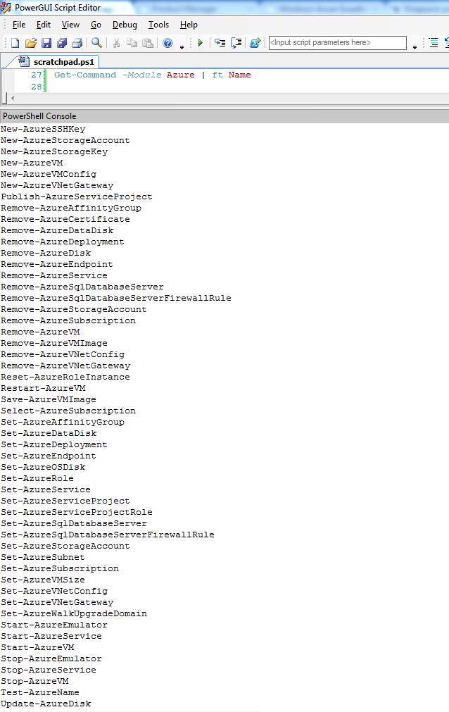
Service Management API
Provides programmatic access to platform functionality
Used to deploy, manage, and monitor applications
Powerful REST API, performed over SSL and mutually authenticated using X.509 certificates
May be accessed from within application running in Windows Azure, or directly over the Internet from any application
Notes:
Slide Objectives:
Explain how Azure helps developers to refocus on their applications.
Speaker Notes:
Before we discuss about specifics, let’s refocus on what you care about – your application/service.
Azure is taking a application-centric approach and brings tools and services to support DevOps scenarios.

Slide 4
What can you do with PowerShell?
Remote Management
Manage SQL Databases, Configuration, Diagnostics, Deployments, and Azure assets (Affinity Groups, Storage Accounts, Keys, etc..)
Automation
Query, Manage and Configure Virtual Machines across multiple subscriptions, cloud services and storage accounts.
Provision Fully Configured Virtual Machines
Domain Joined
Storage and Networking Configured
Virtual Networking
Completely Configure VNETs from a Script
Notes:
Slide Objectives:
Explain how Azure helps developers to refocus on their applications.
Speaker Notes:
Before we discuss about specifics, let’s refocus on what you care about – your application/service.
Azure is taking a application-centric approach and brings tools and services to support DevOps scenarios.

Slide 5
Getting started
Download and Install Windows Azure PowerShell http://go.microsoft.com/?linkid=9811175
Invoke Add-AzureAccount
Automatically configures Subscription ID, Certificate, Service Endpoint and Subscription Name
Multiple Subscription Support
Get-AzureSubscription | foreach {
Select-AzureSubscription $_.SubscriptionName
# Perform Management Operation Against Each Subscription
}
Notes:
Slide Objectives:
Explain how Azure helps developers to refocus on their applications.
Speaker Notes:
Before we discuss about specifics, let’s refocus on what you care about – your application/service.
Azure is taking a application-centric approach and brings tools and services to support DevOps scenarios.

Slide 6


Provisioning VM
Getting Started
Select Image and VM Size
New Disk Persisted in Storage
Windows Server
Management Portal
Boot VM from New Disk
Linux
>_
General Purpose
Basic
Standard
Optimized Compute
Performance Optimized
Network Optimized
Scripting
(Windows, Linux and Mac)
Cloud
REST API
Notes:
Slide Objective:
Explain workflow for provisioning VMs in the cloud
Speaker Notes:
You have three methods of starting this process: Build a VM from the portal, from the command line OR programmatically calling the REST API.
Once your choice of provisioning is made you will need to select the image and instance size to start from.
The newly created disk will be stored in blob storage and your machine will boot.

Slide 7

















VM Gallery
A collection of prebuilt images for various workloads
Windows Server 2012 R2
Ubuntu Server 14.04 LTS
CentOS 6.5
SUSE Linux
Enterprise Server
openSUSE 13.1
Oracle Linux 6.4.0.0.0
SQL Server 2014 Standard
Oracle Database 11g R2
SharePoint Server Farm
Microsoft Dynamics
GP 2013
Zulu 8
BizTalk Server 2013
SAP HANA
Developer Edition
Puppet Enterprise 3.2.3
Barracuda Web Application
Oracle WebLogic
Server 12.1.2
Visual Studio Ultimate 2013
Windows 8.1 Enterprise
Microsoft Azure
Notes:
Slide Objective:
Explain a wide variety of images that you can choose from.
Speaker Notes:
First of all, you can choose from different Windows Servers and a variety of Linux implementations. [Click]
As well as pre-built images for different flavors of SQL Database and Oracle databases. [Click]
You can also choose from a number of first-party and certified third-party images for various application servers and infrastructural components. [Click]
And last but not least, if you are a MSDN subscriber, you also have access to Visual Studio images and client Windows systems such as Windows 7 and Windows 8.1 for your DevTest purposes.

Slide 8

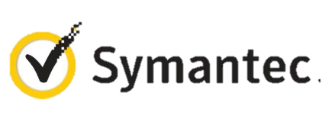

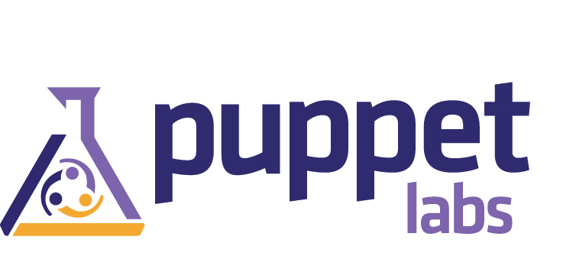
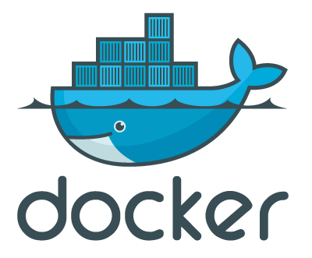

VM Extensions
Installable components to customize VM instances
Enable various DevOps scenarios
Can be added, updated, disabled or removed at any time
Managed via portal, PowerShell and Management APIs
Microsoft Azure
Notes:
Slide Objective:
Introduce VM extensions.
Speaker Notes:
No matter how big the image gallery is, your projects may have specific needs that can’t be satisfied by standard images.
Some components such as anti-virus, configuration management agents are required on most machines for compliance and management purposes.
This allows use to innovate faster to meet with your project needs. And you have flexibility to pick and combine extensions for your goals.
Point out some of existing extensions:
Custom Script Extension, which allows you to download and execute PowerShell scripts.
Chef Extension and Puppet Extension for automated management at scale.
Symantec Endpoint Protection etc. for protection.
Docker (Linux only).
Visual Studio Remote Debugger.

Slide 9
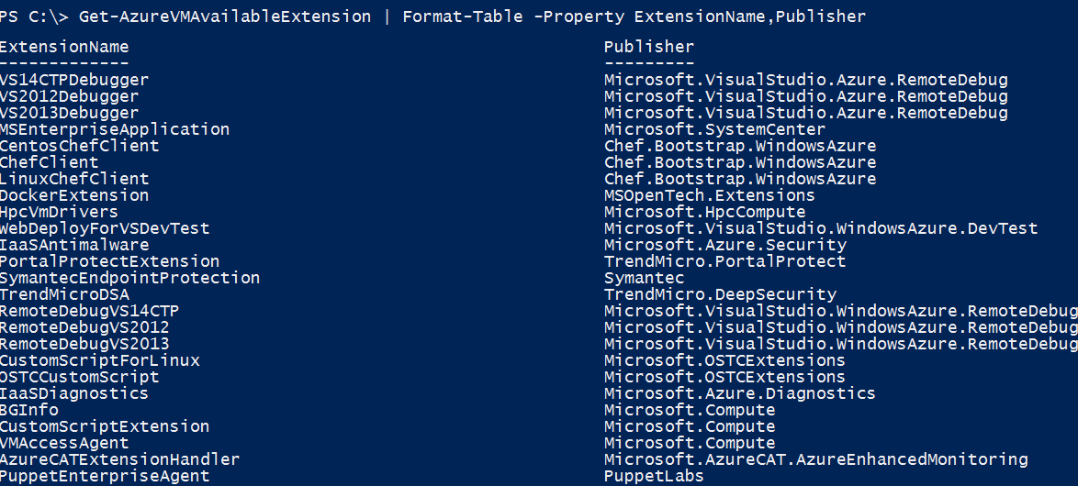
VM Extensions
List available VM extensions
Microsoft Azure

Slide 10
Virtual Machine Management
Quick VM Provisioning Mode
Supports VM Creation in a Single Cmdlet
Advanced Provisioning Configuration Mode
Provision With: Endpoints, Data Disks
Configure: Cache Settings for OS/Data Disks and Subnet Names
Create Multiple Pre-Defined VMs in a Batch
New-AzureVM -VMs $vm1, $vm2, $vm3
Notes:
Slide Objectives:
Explain how Azure helps developers to refocus on their applications.
Speaker Notes:
Before we discuss about specifics, let’s refocus on what you care about – your application/service.
Azure is taking a application-centric approach and brings tools and services to support DevOps scenarios.

Slide 11
Setting the current storage account
Returns Storage Account
Get-AzureStorageAccount | Select StorageAccountName
Sets the Current Storage Account
Set-AzureSubscription 'somesub1' -CurrentStorageAccount 'mystorage‘
Cmdlets like New-AzureQuickVM will use this Account
Notes:
Slide Objectives:
Explain how Azure helps developers to refocus on their applications.
Speaker Notes:
Before we discuss about specifics, let’s refocus on what you care about – your application/service.
Azure is taking a application-centric approach and brings tools and services to support DevOps scenarios.

Slide 12
Information needed to create a VM
Image Name
Get-AzureVMImage | select ImageName
Disk Name
Get-AzureDisk | select DiskName
Data Center Location
Get-AzureLocation
Notes:
Slide Objectives:
Explain how Azure helps developers to refocus on their applications.
Speaker Notes:
Before we discuss about specifics, let’s refocus on what you care about – your application/service.
Azure is taking a application-centric approach and brings tools and services to support DevOps scenarios.

Slide 13
Simple VM creation
First Virtual Machine in a NEW Cloud Service (-Location specified)
New-AzureQuickVM -Windows -ServiceName $svc -Name $vm1 -ImageName $wimg -Location $location -Password $pwd
New Virtual Machine in an Existing Cloud Service(no -Location)
New-AzureQuickVM -Windows -ServiceName $svc -Name $vm2 -ImageName $wimg -Password $pwd
Creating a Linux Virtual Machine in an Existing Cloud Service
New-AzureQuickVM -Linux -ServiceName $svc -Name $vm3 -ImageName $limg -LinuxUser $lu -Password $pwd
Notes:
Slide Objectives:
Explain how Azure helps developers to refocus on their applications.
Speaker Notes:
Before we discuss about specifics, let’s refocus on what you care about – your application/service.
Azure is taking a application-centric approach and brings tools and services to support DevOps scenarios.

Slide 14
Virtual Machine Discovery
Retrieve Cloud Services
Get-AzureService
Retrieve Virtual Machines for Service
Get-AzureVM -ServiceName $cloudSvcName
Retrieve Status for All VMs in Subsription
Get-AzureService | foreach {
$_ | Get-AzureVM | ft ServiceName, Name, InstanceStatus
}
Notes:
Slide Objectives:
Explain how Azure helps developers to refocus on their applications.
Speaker Notes:
Before we discuss about specifics, let’s refocus on what you care about – your application/service.
Azure is taking a application-centric approach and brings tools and services to support DevOps scenarios.

Slide 15
Common settings
Name
The name of the Virtual Machine
AvailabilitySetName
The availability set (used for high availability)
InstanceSize
ExtraSmall, Small, Medium, Large, ExtraLarge
Notes:
Slide Objectives:
Explain how Azure helps developers to refocus on their applications.
Speaker Notes:
Before we discuss about specifics, let’s refocus on what you care about – your application/service.
Azure is taking a application-centric approach and brings tools and services to support DevOps scenarios.

Slide 16
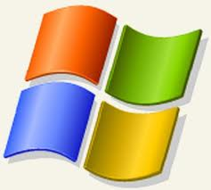

Provisioning options
Add-AzureProvisioningConfig
-Windows -Password $pwd
-WindowsDomain -Password $pwd
-Domain $dom, -JoinDomain $fqdn, -DomainUser $domUser
-DomainPassword $domPwd -MachineObjectOU $ou
-DisableAutomaticUpdates
-NoRDPEndpoint, -TimeZone, Certificates
Add-AzureProvisioningConfig
Linux
-LinuxUser $user -Password $pwd
-DisableSSH , -NoSSHEndpoint
-SSHKeyPairs, -SSHPublicKeys
Notes:
Slide Objectives:
Explain how Azure helps developers to refocus on their applications.
Speaker Notes:
Before we discuss about specifics, let’s refocus on what you care about – your application/service.
Azure is taking a application-centric approach and brings tools and services to support DevOps scenarios.

Slide 17
Setting VM configuration
New-AzureVMConfig -Name $vm1 -InstanceSize Medium -ImageName $img |
Add-AzureProvisioningConfig -Windows -Password $pwd |
Add-AzureDataDisk -CreateNew -DiskLabel 'data' -DiskSizeInGB 10 -LUN 0 |
Add-AzureEndpoint -Name 'web' -PublicPort 80 -LocalPort 80 -Protocol tcp |
New-AzureVM -ServiceName $newSvc -Location $location
Notes:
Slide Objectives:
Explain how Azure helps developers to refocus on their applications.
Speaker Notes:
Before we discuss about specifics, let’s refocus on what you care about – your application/service.
Azure is taking a application-centric approach and brings tools and services to support DevOps scenarios.

Slide 18
Disks and Images
OS Images
Microsoft
Partner
User
Base OS image for new Virtual Machines
Sys-Prepped/Generalized/Read Only
Created by uploading or by capture
Disks
OS Disks
Data Disks
Writable Disks for Virtual Machines
Created during VM creation or during upload of existing VHDs.
Notes:
Slide Objective:
Explain the differences between disks and images with VMs

Slide 19
Image Mobility
On-Premises
Cloud
MyApp.vhd
Notes:
Slide Objective:
Explain the benefits of image mobility
Notes:
One of the key benefits of IaaS is flexibility and control. The Microsoft Azure solution provides the capability of not only moving VHDs TO the cloud but also allows you to copy the VHD back down and run it locally or on another cloud provider. Great for testing out production issues or any other need where you require a copy of the production server.

Slide 20
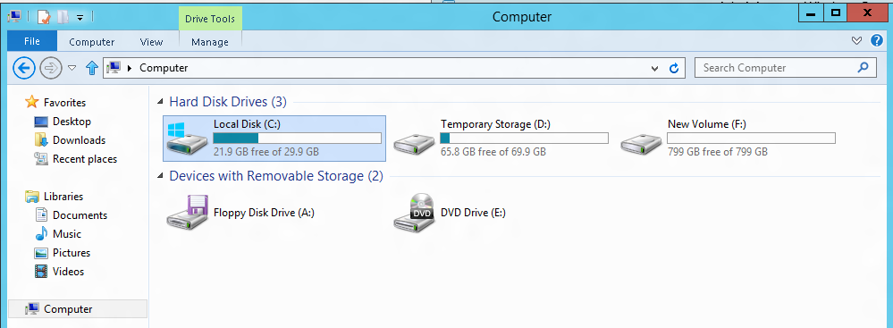
VM disk layout
OS Disk
Persistent
SATA
Drive C:
Temporary Storage Disk
Local (Not Persistent)
SATA
Drive D:
Data Disk(s)
Persistent
SCSI
Customer Defined Letter

Slide 21
Data disk creation
New Virtual Machine Creation with Data Disk
New-AzureVMConfig -Name 'myvm1' -InstanceSize 'Small' -ImageName $img |
Add-AzureProvisioningConfig -Windows -Password $pwd |
Add-AzureDataDisk -CreateNew -DiskSizeInGB 10 -DiskLabel 'myddisk' -LUN 0 |
New-AzureVM -ServiceName $cloudSvcName
Add new Data Disk to existing Virtual Machine
Get-AzureVM -ServiceName 'myvm1' |
Add-AzureDataDisk -CreateNew -DiskSizeInGB 10 -DiskLabel 'myddisk' -LUN 1 |
Update-AzureVM
Notes:
Slide Objectives:
Explain how Azure helps developers to refocus on their applications.
Speaker Notes:
Before we discuss about specifics, let’s refocus on what you care about – your application/service.
Azure is taking a application-centric approach and brings tools and services to support DevOps scenarios.

Slide 22
Disk and image repository
OS Images
Get-AzureVMImage # Return all
Get-AzureVMImage | Where { $_.Category -eq 'Microsoft' } # Return Microsoft
Get-AzureVMImage | Where { $_.Category -eq 'User' } # Return Custom
Get-AzureVMImage | Where { $_.Category -eq 'Partner' } # Return Partner Images
Get-AzureVMImage | Where { $_.OS -eq 'Windows' } # Return only Windows OS images
Remove-AzureVMImage -ImageName 'myimg' -DeleteVHD # Delete image and storage
Add-AzureVMImage -OS 'Windows' -ImageName 'MyWinImage' -MediaLocation 'http://storageaccount/vhds/winimage.vhd' # Add Existing VM Image from Storage
Microsoft, Partner and User
Disks
Get-AzureDisk # Return all
Get-AzureDisk | Where { $_.AttachedTo -eq $null } # Return all not attached to a VM
Get-AzureDisk | Where { $_.OS -eq $null } # Return only data disks
Get-AzureDisk | Where { $_.OS -eq 'Windows' } # Return only Windows OS disks
Remove-AzureDisk -DiskName 'mydisk' -DeleteVHD # Delete disk and storage
Add-AzureDisk -OS 'Windows' -DiskName 'MyWinDisk' -MediaLocation 'http://storageaccount/vhds/winosdisk.vhd‘ # Add Existing OS Disk from Storage
Add-AzureDisk -DiskName 'MyDataDisk' -MediaLocation 'http://storageaccount/vhds/datadisk.vhd‘
# Add Existing Data Disk from Storage
OS Disks or Data Disks
Notes:
Slide Objectives:
Explain how Azure helps developers to refocus on their applications.
Speaker Notes:
Before we discuss about specifics, let’s refocus on what you care about – your application/service.
Azure is taking a application-centric approach and brings tools and services to support DevOps scenarios.

Slide 23
Customer Manager Architecture
PowerShell script. Performs
automated deployment
and VM configuring
Service Management API
CustomerManager
web app deployed
CustomerManager DB
deployed
IISVM1
CustomerManager
web app deployed
SQLServer
Load Balancer
IISVM2
End Users

Slide 24
Automating CustomerManager App
Provision 2 frontend servers and 1 backend
Remote PowerShell to VMs and configure its parameters: web server, firewall rules, app pools, etc.
Compile and build CustomerManager. Deploy the package to frontend servers. Point frontend to SQL VM
Run CustomerManager and observe results
Notes:
Slide Objectives:
Explain how Azure helps developers to refocus on their applications.
Speaker Notes:
Before we discuss about specifics, let’s refocus on what you care about – your application/service.
Azure is taking a application-centric approach and brings tools and services to support DevOps scenarios.

Slide 25
Demo: Provisioning VM
Managing VMs using PowerShell
Notes:
Demo: Provisioning VM
Prerequisites:
A Windows Server 2012 is already provisioned.
Steps:
Open Ibiza portal and click the NEW button at the lower-left corner.
Show the short list of resources. Explain that I can directly create popular resources here such as a Windows Server 2012.
Click on the Everything link.
In Gallery blade, open the Virtual machines category.
Scroll down the view and show images of different types (refer back to slide 9).
Click on Windows Server 2012 R2, and then click the Create button in the overview blade. For non-Microsoft focused audience, consider to pick a Linux image instead.
Fill in the Create VM form and click on the Create button to provision the VM. Explain this will take a few minutes.
Open the already provisioned VM.
Scroll down the blade to show various of information available on the blade.
Click on the Extensions tile.
On the Extensions blade, click on the ADD icon to bring up the extension list. Introduce that VM extensions are installable components to customize VM instances.
Switch to slides to continue with VM extension introduction.

Slide 26
Migrating apps to the Cloud

Slide 27
Migration Approaches
Build Virtual Machine in the Cloud
Lowers upload time and dependency risk
Requires upload and installation of application and data
Migrating an existing virtual machine
Application, configuration and data in an installed working state
Requires uploading a large amount of data and higher risk of drivers or other hardware dependencies on VM not available in the cloud
Notes:
Slide Objectives:
Explain how Azure helps developers to refocus on their applications.
Speaker Notes:
Before we discuss about specifics, let’s refocus on what you care about – your application/service.
Azure is taking a application-centric approach and brings tools and services to support DevOps scenarios.

Slide 28

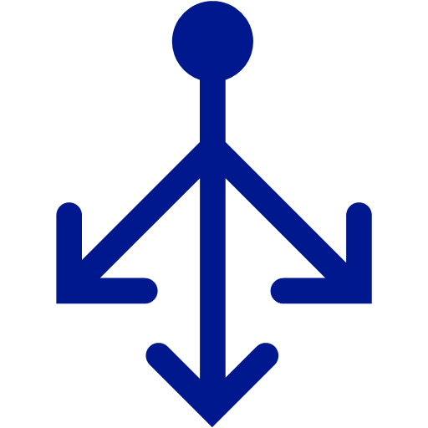


Migrating a Multi-VM application
Cloud Service Acts as a Network Boundary
All VMs in the same service can communicate directly.
Name resolution between VMs is automatic with Windows Azure provided DNS
Cloud Service
Name: bootcamp2015kh.cloudapp.net
Load Balancer
Public IP
VM Name: iisvm1
10.1.5.6
DIP
VM Name: iisvm2
10.1.5.7
DIP
DIP
VM Name: sqlvm1
10.1.5.8
Notes:
Slide Objectives:
Explain how Azure helps developers to refocus on their applications.
Speaker Notes:
Before we discuss about specifics, let’s refocus on what you care about – your application/service.
Azure is taking a application-centric approach and brings tools and services to support DevOps scenarios.

Slide 29
Virtual Machine Configuration
Windows Azure supports VHD file format
Other formats will have to be converted or migrated before upload
Upload existing VHDs using CSUpload.exe
Supports resuming failed transfers
Converting from dynamic to fixed disk on Upload
Efficient upload – does not send empty bytes
Things to do before uploading OS disk
Enable Remote Access
Notes:
Slide Objectives:
Explain how Azure helps developers to refocus on their applications.
Speaker Notes:
Before we discuss about specifics, let’s refocus on what you care about – your application/service.
Azure is taking a application-centric approach and brings tools and services to support DevOps scenarios.

Slide 30

Migrating a simple virtual machine
Migration Steps
Cloud Service
Name: myapp.cloudapp.net
On Premises VM
Machine Name: APPSRV1
Memory: 8Gb
Cores: 4
Ports: 80/443 http/https
Upload VHDs
CSUpload or other tools
Virtual Machine
Role Name: appsrv1
4 cores
7 Gb RAM
Ports 80/443
2) Create VM
OS disk = APP-OS.vhd
3) Configure data disks
Data Disk 1 = App-Data.vhd
Data Disk 2 = App-Logs.vhd
Guest: C:\
Host: C:\VMs\APP-OS.vhd
Guest: C:\
Host: C:\VMs\APP-OS.vhd
Guest: D:\
Host: D:\VMs\APP-Data.vhd
4) Adjust app for drive letters
Guest: E:\
Host: E:\VMs\APP-Data.vhd
5) Add Endpoints (80/443)
Guest: E:\
Host: E:\VMs\APP-Logs.vhd
Guest: F:\
Host: F:\VMs\APP-Logs.vhd
Windows Azure Storage
Notes:
Slide Objectives:
Explain how Azure helps developers to refocus on their applications.
Speaker Notes:
Before we discuss about specifics, let’s refocus on what you care about – your application/service.
Azure is taking a application-centric approach and brings tools and services to support DevOps scenarios.

Slide 31

Imaging VMs in the Cloud
Cloud
Base VHD
Capture VM saves customized image to your image library
Blob Storage
Boot VM
Customize VHD
Generalize VHD
Capture VM
Notes:
Slide Objectives:
Explain how Azure helps developers to refocus on their applications.
Speaker Notes:
Before we discuss about specifics, let’s refocus on what you care about – your application/service.
Azure is taking a application-centric approach and brings tools and services to support DevOps scenarios.

Slide 32
Azure Virtual Networks
→ A protected private virtual network in cloud
→ Extend enterprise networks into Azure
→ Cross-premises connectivity

Slide 33
Virtual Network Scenarios
Hybrid Public/Private Cloud
Enterprise app in Microsoft Azure requiring connectivity to on-premise resources
Enterprise Identity and Access Control
Manage identity and access control with on-premise resources (on-premises Active Directory)
Monitoring and Management
Remote monitoring and trouble-shooting of resources running in Azure
Advanced Connectivity Requirements
Cloud deployments requiring IP addresses and direct connectivity across services
Microsoft Azure

Slide 34

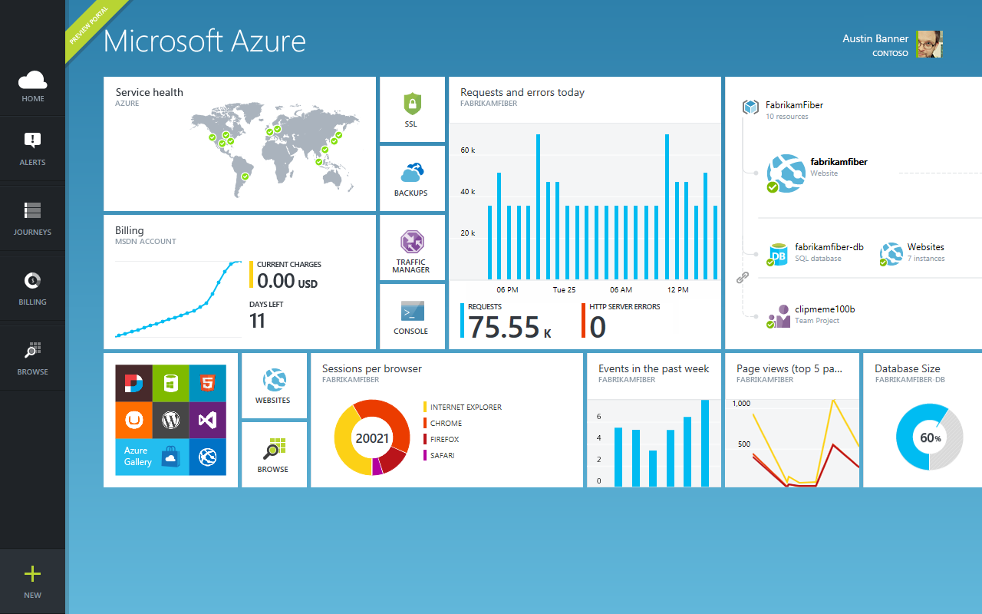
Questions

